Slide 1


Kickstarter Analysis
Fatima Sayed Adnan
Sayed Hassan Hadi
Amina Marhoon
Saad Nazzal

Slide 2
Agenda
Why Kickstarter?
Data Analysis and Chart Visualization
Successful VS Failed Projects
Recommendation & Limitations

Slide 3
Why Choose Kickstarter For Your Next Big Idea?
Pros
Access to Funding
Large Audience
Marketing and Exposure
Community Engagement
Cons
High Competition
Limited Timeframe
All-or-Nothing Funding
Pressure to Deliver

Slide 4
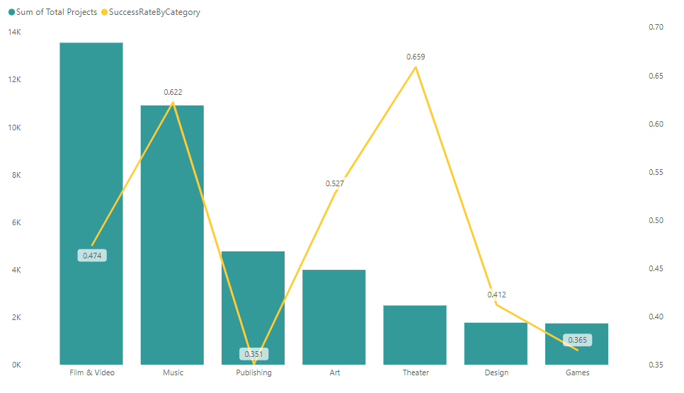
Success Rate For Top 7 Categories

Slide 5
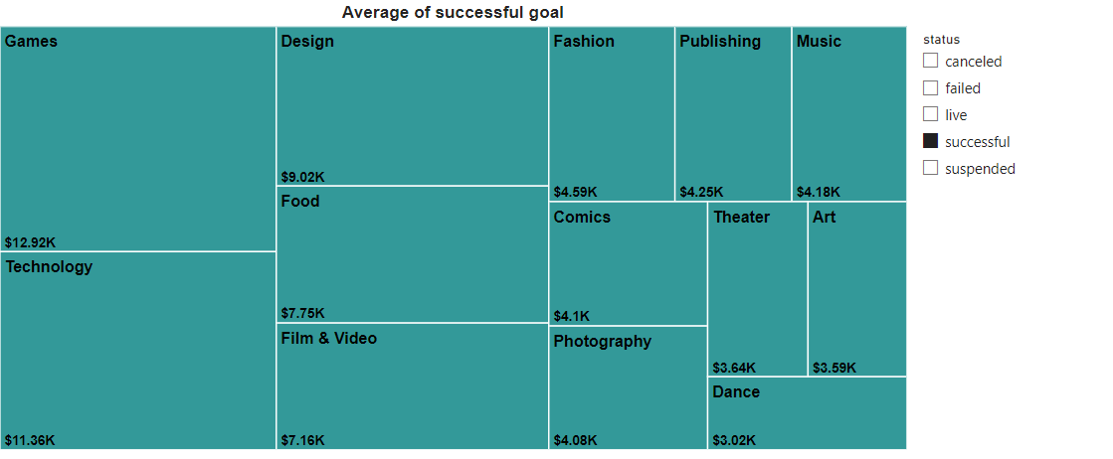
Categories With Their Average Best Goals

Slide 6
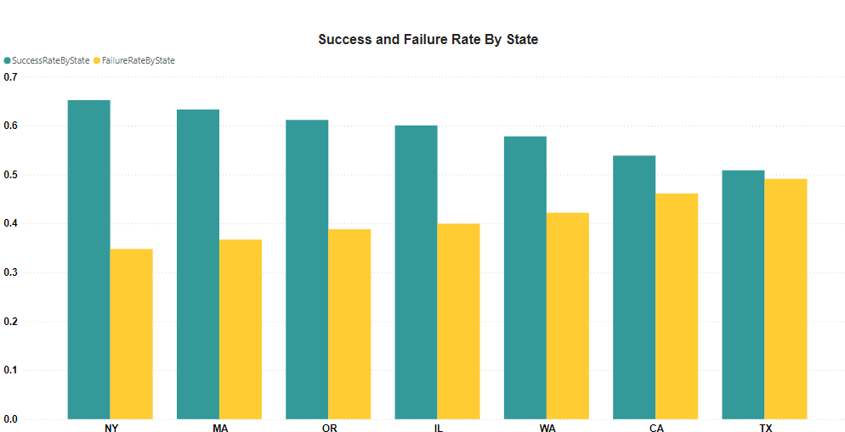
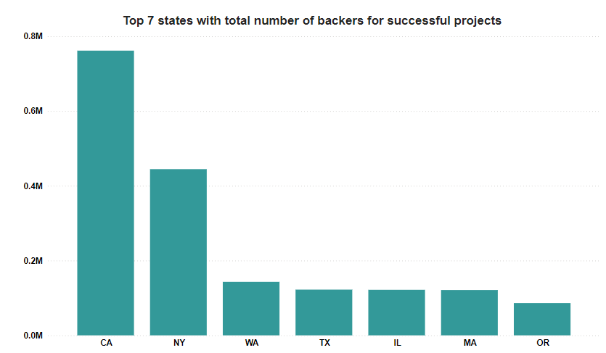
These 7 states have the highest success rate and the most backers

Slide 7
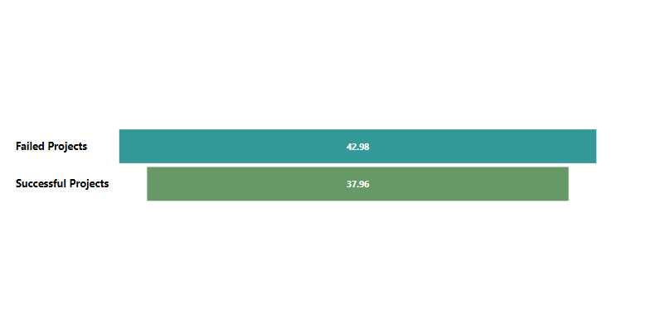
Average Duration For Successful Projects is 37.96 Days

Slide 8
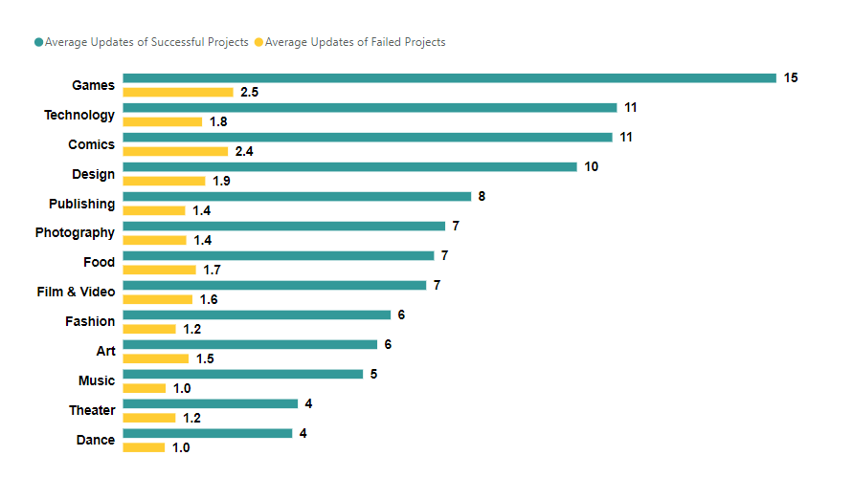
The Average Updates For Successful Projects is Over 3 Updates

Slide 9
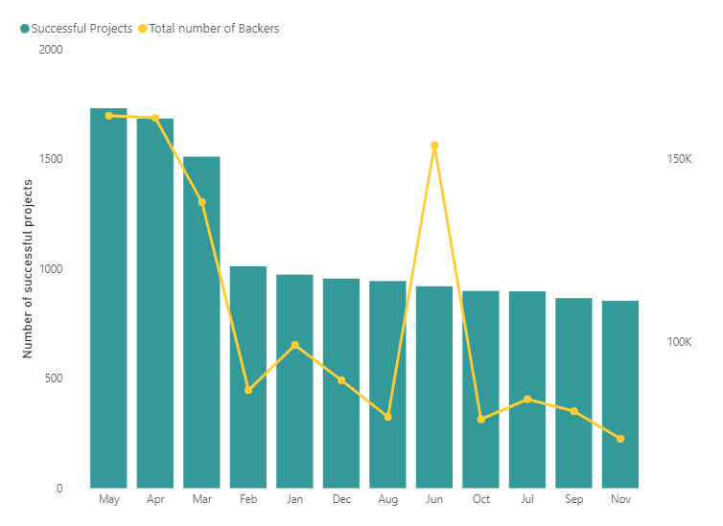
March, April & May Have The Most Successful Projects Supported By Backers

Slide 10
Successful VS. Failed Projects
Successful
Engage with backers and keep them in the loop
Set realistic goals
Set realistic funding period
Well-structured rewards system
Failed
Minimum or no engagement with backers
Set unrealistic goals
Poorly-structured rewards system

Slide 11
Recommendations & Limitations
Recommendations
Optimize project launch timing
Enhance communication with backers
Setting realistic and relevant goals for project success
Limitations
Lack of data on “Campaign Videos”
External factors influence
Limited data range
Category variability

Slide 12
Thank You!

